Slide 1
Final Project
Veteran Analysis by
Fritz Knack, Stacey Hart, Ron Bingham

Slide 2

Veteran Analysis
We retrieved census data from Kaggle for 2015-2019 for the following:
Veteran population for US states including Race, Education, and Employment stats
Overall population for all citizens for the same date range
Latitude and Longitude of states for use in visualization
The purpose of this project is to analyze the data for veteran population over a span of time compared to total population. Take this data set and put in a machine learning model to predict future enlistment for each state.

Slide 3
Resources/Tools
In this project we utilized Pandas, Jupyter Notebook, AWS, Postgres, and Tableau. We initially cleaned the data sets into usable pandas DataFrames and exported them to csv files. This data was then added to Postgres in order to join/merge the data to place into a machine learning model.

Slide 4
Code Samples
In the next few slides there are examples of code where the date was cleaned into usable DataFrames to easily be added to SQL tables in Postgres.

Slide 5
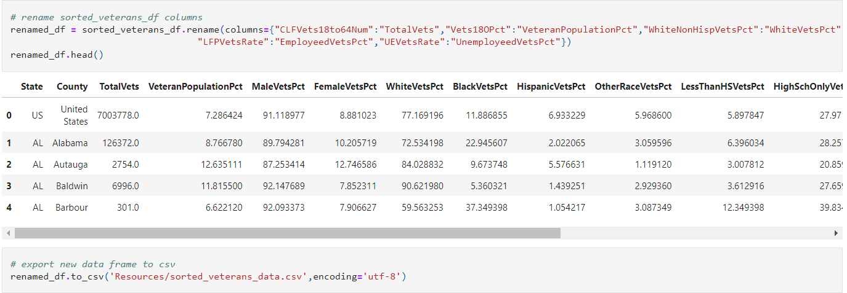
Code Example

Slide 6
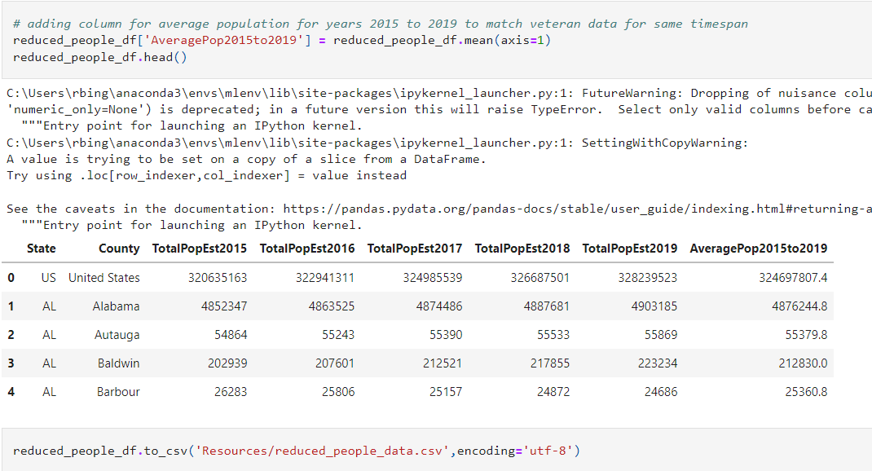
Code Example

Slide 7
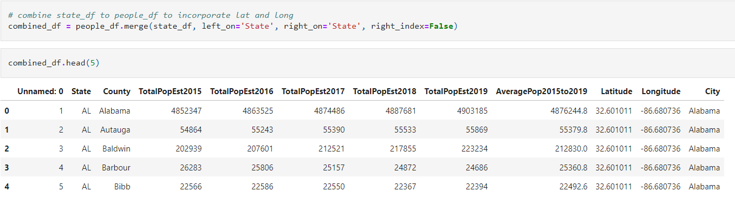
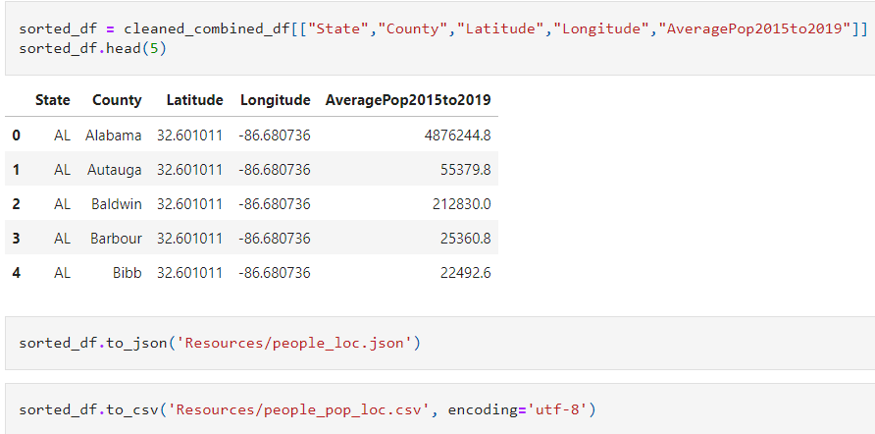
Code Example

Slide 8
Code Challenges
When reviewing the DataFrame outputs, it was noticed that there were 3 major concerns.
Needed to change the populations in both data sets to be integers (whole numbers) instead of floating with decimals
In the veteran dataset, every column except the total population was listed as percentages. Had to refactor the DataFrame to provide a whole number output instead of the percentages.
Review of both data sets showed there were rows for each state that mentioned the state name as county. This was a concern since that row showed the total for the state and needed to be removed to ensure those outliers would not be present when working with the machine learning model
The following slide shows the final refactored DataFrames.

Slide 9
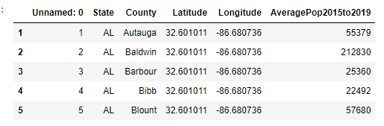
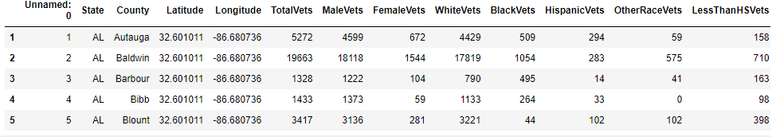
Code Example
Final state people data output removing the state/county concern and having whole number data
Final state veteran data output removing the state/county concern and having percents converted to whole numbers

Slide 10
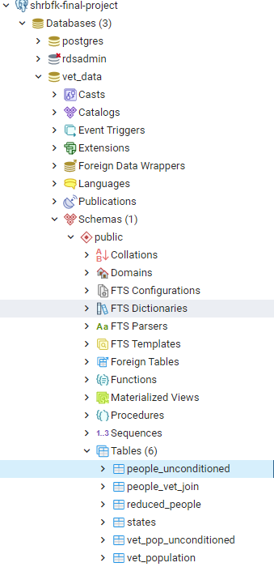
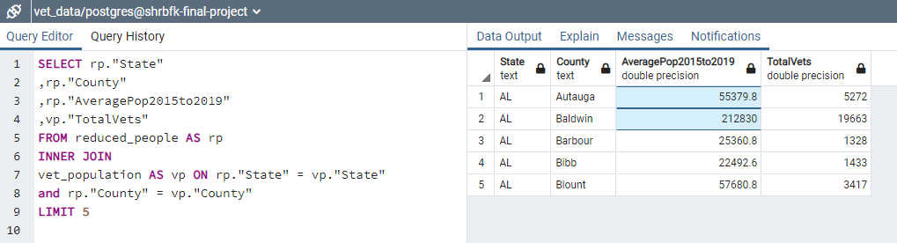
Postgres

Slide 11
Machine Learning
Multiple Linear Regression, Lasso Regression, Ridge Regression
Linear regression- provides a good sense of whether model is suffering from over or under-fitting.
Ridge-helps reduce model complexity and multi-collinearity
Lasso-helps reduce over-fitting and can also help with feature selection

Slide 12
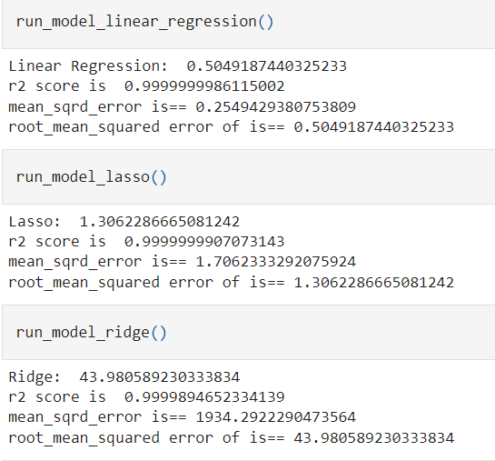
Machine Learning Results

Slide 13
Visualization
The following slides are snippets from the Tableau story created from our data sets. The slides include potential other data sets for review outside of populations addressed in the project i.e., Race, Employment, Gender, and Education Data for Veterans.
Tableau story can be found here: https://public.tableau.com/views/FinalProject_16450225195590/VeteranData?:language=en-US&publish=yes&:display_count=n&:origin=viz_share_link

Slide 14
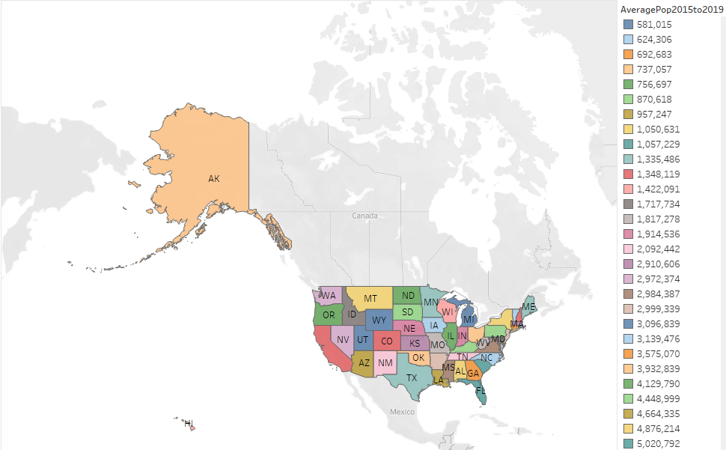
Visualization (Total Population Per State)

Slide 15
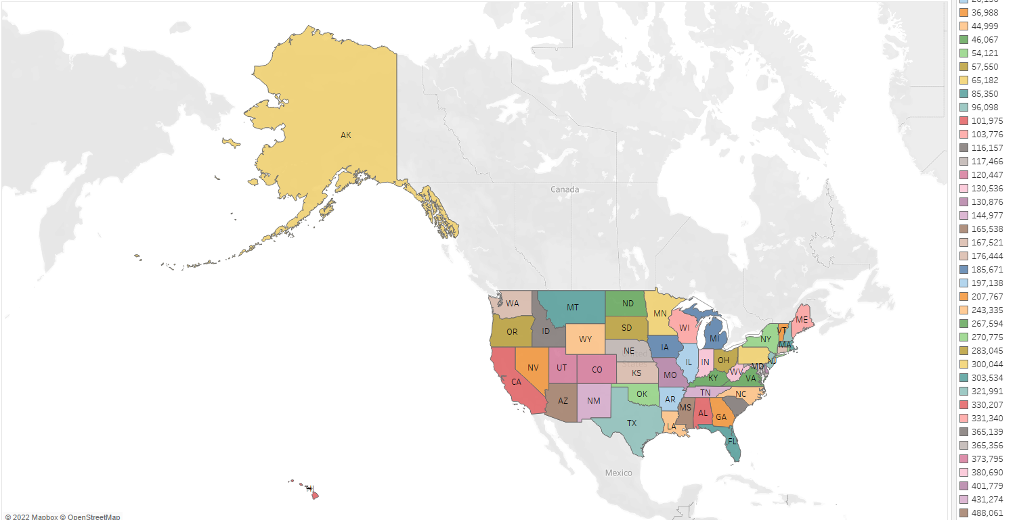
Visualization (Veteran Population Per State)

Slide 16
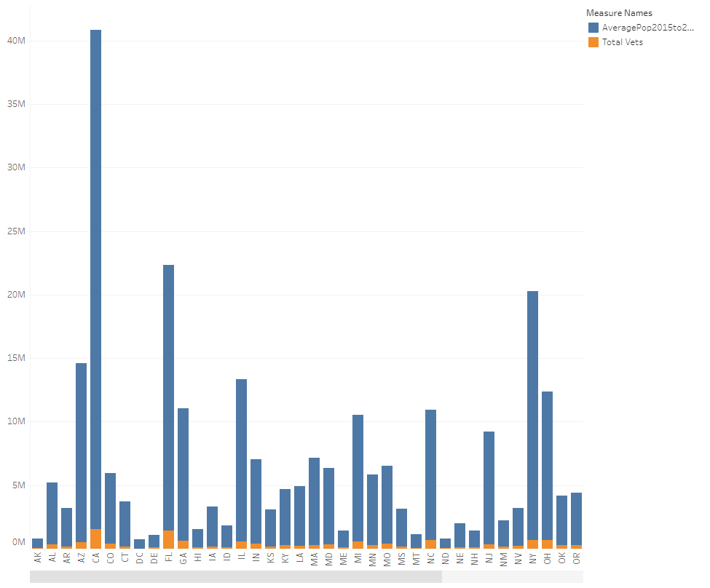
Visualization (Veteran Population vs Total Population Per State)

Slide 17
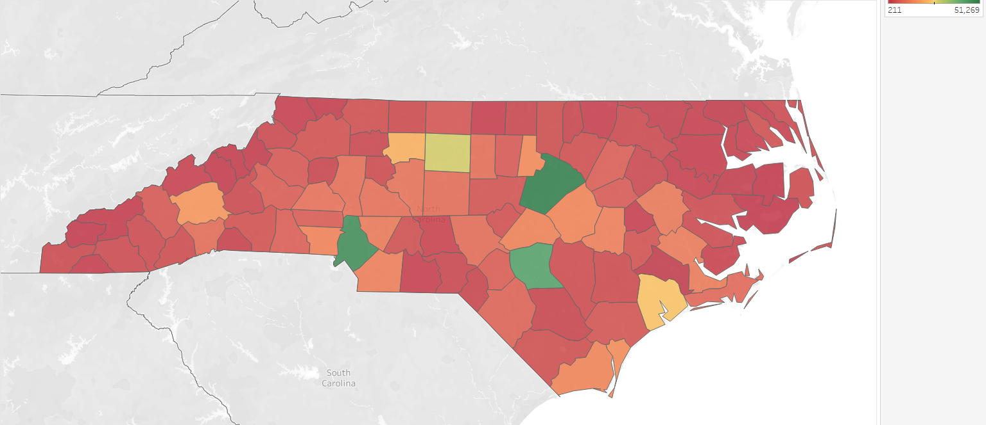
Visualization (Veteran Population Per County)

Slide 18
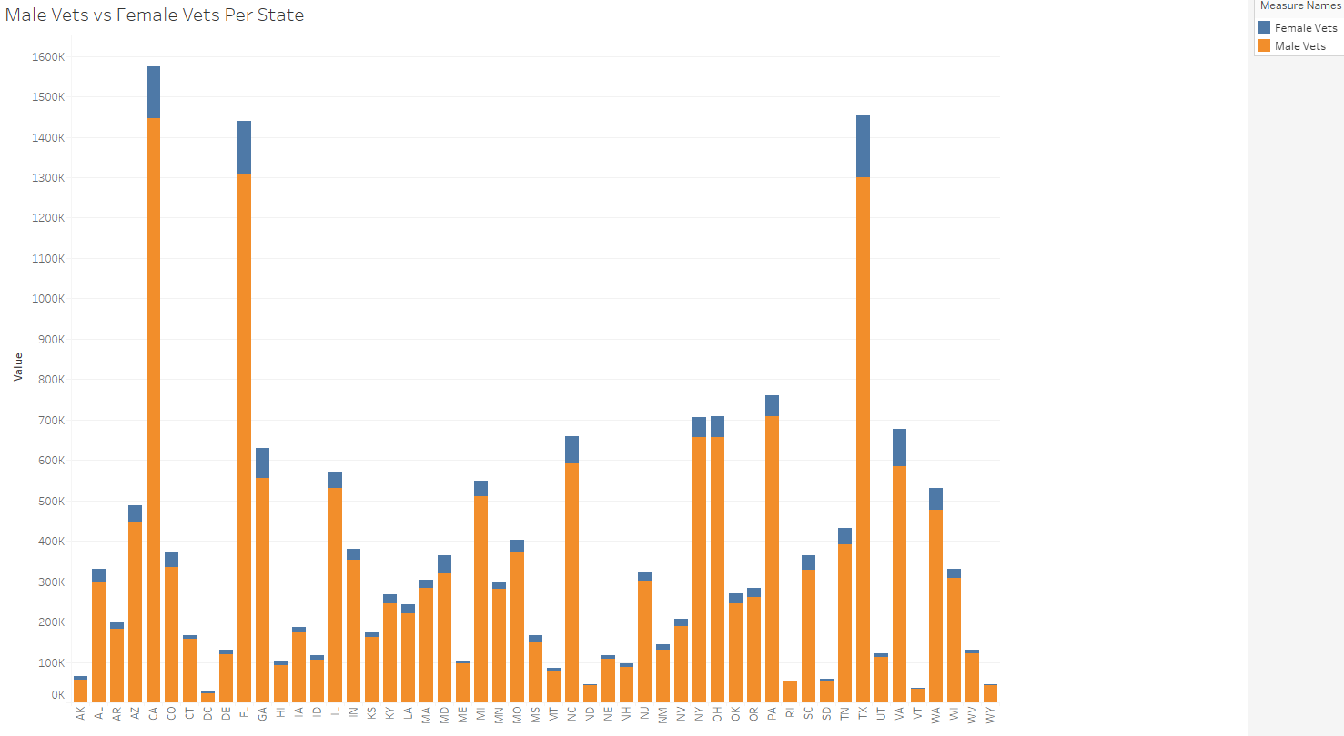
Visualization (Potential Data Sets for Model)
Veterans Per State by Gender

Slide 19
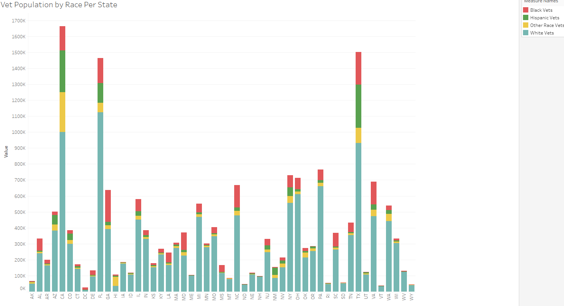
Visualization (Potential Data Sets for Model)
Veterans Per State by Race

Slide 20
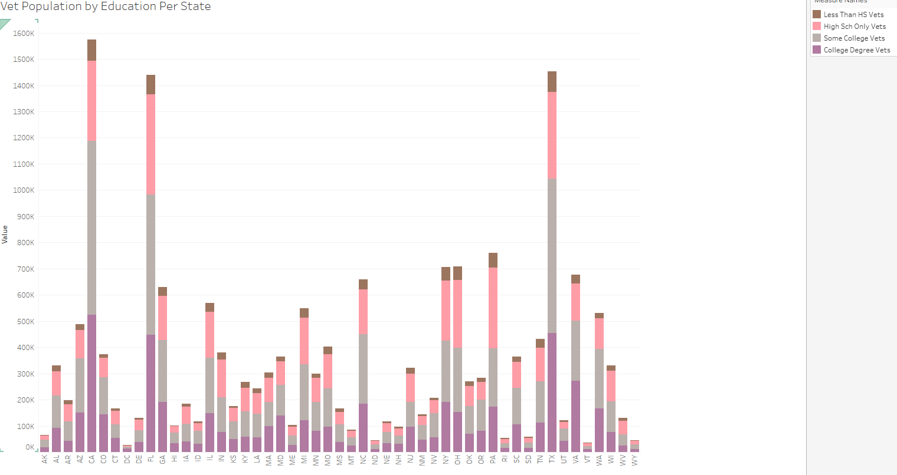
Visualization (Potential Data Sets for Model)
Veterans Per State by Education

Slide 21
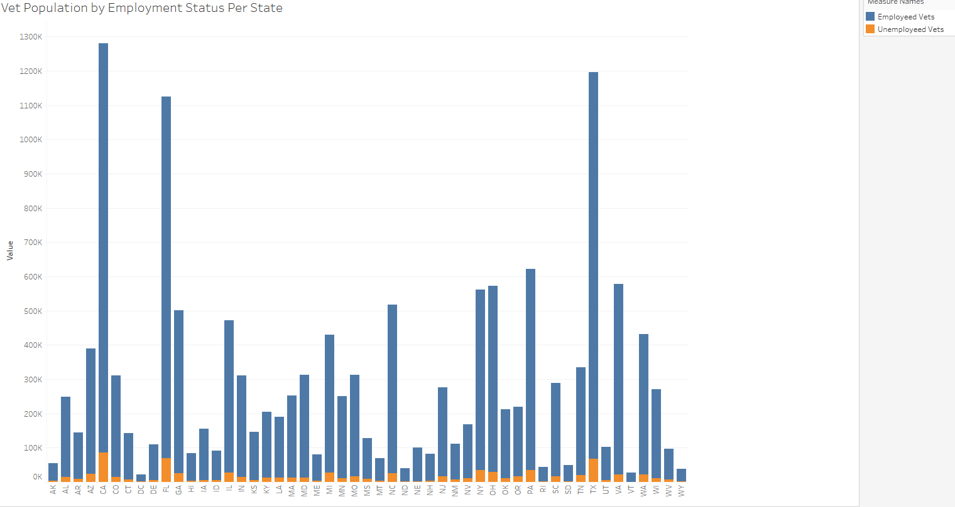
Visualization (Potential Data Sets for Model)
Veterans Per State by Employment Status

